Slide 1


Financial Management
Innovation, Incubation and Entrepreneurship

Slide 2


Finance is the lifeblood of a business

Slide 3

Financial Management
Managerial activity concerning the finance of the firm. It deals with planning, control and management of financial resource of the firm.

Slide 4

Functions of Finance
Routine Finance Function
Supervision of cash receipts and payments
Safeguarding cash balances
Record keeping (accounting)
Custody and safeguarding of securities, insurance policies, and other important documents
Taking care of the mechanical details of outside finances
Regular return of borrowed funds.
Managerial Finance Function
Estimating financial requirements
Identifying sources of finance
Raising of finance
Proper use of finance
Control of finance

Slide 5
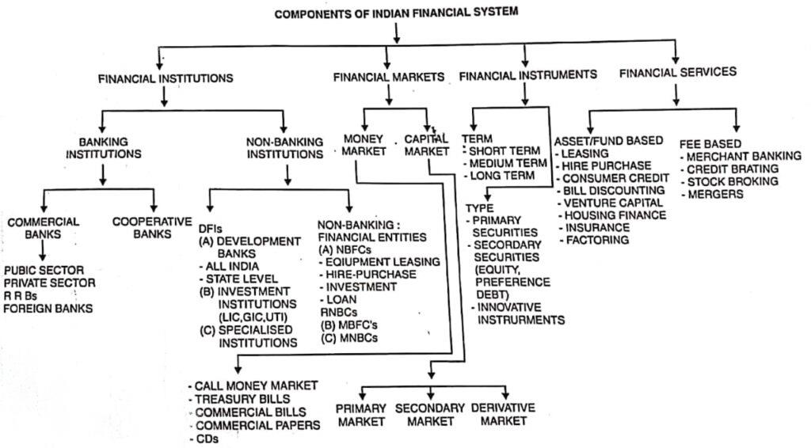

Slide 6
Ratio Analysis
Ratio analysis seeks to measure and establish cause-and-effect relationships between either two items of a balance sheet or of a profit and loss account, or both the balance sheet and the profit and loss account. Thus, ratio analysis is a more focused analysis of financial statements. The interpretation of results for decision making is the most critical part of ratio analysis.
Significance
Financial Ratio
Liquidity Ratio
Activity/ Turnover Ratio
DuPont Analysis
Debt/ Solvency Ratio
Profitability Ratio
Capital Market Ratios
Comparison against industry benchmarks.
Inter-firm comparison because absolute figure comparison will not be conclusive
Analysis of chronological performance over a long period.
Intra-firm comparison.

Slide 7
Liquidity Ratios
The liquidity of a firm is measured by its ability to satisfy its short-term obligations as they come due The capacity of an enterprise to discharge its suppliers and service providers and to meet its day-to-day expenses indicates its liquidity and ensures the smooth continuity of operations, which in turn, has a strong bearing on the long-term survival of the company.
Current ratio=Current assets/Current liabilities
Quick ratio (acid-test) ratio Current assets (Inventory/Current liabilities)
Collection period to customers (days) Receivables (365/Credit sales)
Suppliers credit (days) Payables (365/Credit purchases)
Inventory-holding period Inventory (365/Cost of goods sold)

Slide 8
Activity/Turnover Ratios
Activity ratios measure the speed with which various accounts are converted into sales or cash inflows or outflows. The efficiency with which the assets and resources of a company are utilized in generating operational revenue has a direct bearing on the top line. It is, therefore, important to study the turnover ratios.
Inventory turnover = Cost of goods sold/Inventory
Average collection period = Accounts receivable/Average sales per day
Average payment period = Accounts payable/Average purchases per day
Total asset turnover = Sales/Total assets

Slide 9
Debt/Solvency Ratios
The capacity of an enterprise to discharge its obligations towards long-term lenders indicates its financial strength and ensures its long-term survival. The debt position of a firm indicates the amount of other people's money being used to generate profits. It is important to analyse the capacity of an enterprise to raise further capital borrowings. These are particularly useful for financial institutions, banks, and other lenders to assess the creditworthiness of a company and the attendant financial default risk.
Debt ratio = Total liabilities / Total assets
Net asset value (NAV) = Equity shareholders' funds / No, of equity shares
Debt equity ratio = Long-term debt Total net worth
Interest cover ratio (Interest cover) = PAT interest on long-term debt (Non-cash charges/Interest on long-term debt)
Debt-coverage service (DSCR ratio) = PAT+ Interest on long-term debt+ (Non-cash charges Interest on long-term debt) + Installments of principal due

Slide 10

Profitability Ratios
Profitability ratios enable the analyst to evaluate the firm's profits with respect to a given level of sales, a certain level of assets, or the owner's investment. These ratios analyse the profitability of an enterprise at different steps or at intermediate levels of business activities.
Gross profit margin-Gross profits sales
Operating profit margin-Operating profits/sales
Net profit margin-Earnings available for common stockholders/Sales
Earnings per share (EPS) = $\frac{Earnings available for common stockholders}{Number of shares of common stock outstanding}$
Return on total assets (ROA) = Earnings available for common stockholders / Total assets
Return on common equity (ROE) = Earnings available for common stockholders / Common stock equity
Return on net worth (RONW) = (PAT-Preference dividend/Equity shareholder's funds or net worth) $×$100

Slide 11
Capital Market Ratios
The capital market has become a major source of capital, both for equity as well as bonds and debentures for the industry. Market ratios relate a firm's market value, as measured by its current share price, to certain accounting values. It is necessary for the entrepreneur to have a knowledge of these ratios.
Price/earnings (P/E) ratio = Market price per share of common stock / Earnings per share
Market/book (M/B) ratio = Market price per share of common stock / Common stock equity

Slide 12
Break-Even Analysis
A
BEP is a calculation that forecasts the point at which a company’s total revenues are equal to its total expenses.
BEP is the point of business operations when the business neither earns any profit nor any loss.
Break even analysis focuses on the relationship between fixed cost, variable cost and selling price.
C
Cost
P
Variable Costs
Break-even Point
B
Fixed Costs
Loss
Profit
Q
Output
$$Break−Even Point= \frac{Fixed Costs}{Selling price per unit −Variable Cost}$$

Slide 13
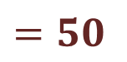
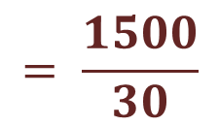
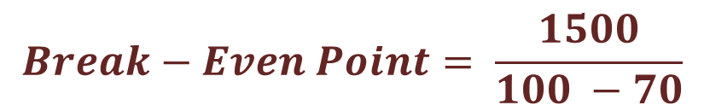
The data regarding the fixed costs and variable costs of a company are given below. If the company has to break even, how many units should it sell?
Fixed Costs:
Monthly Rent: 1000/-
Insurance: 500/-
Total monthly fixed costs: 1500/-
Variable Cost:
Materials: 30/-
Labour: 40/-
Total variable cost: 70/-
Selling Price: 100/-
$$Break−Even Point= \frac{Fixed Costs}{Selling price per unit −Variable Cost}$$
$$Break−Even Point= \frac{1500}{100 −70}$$
$$= \frac{1500}{30}$$
$=50$
The company should sell 50 unites per month to break even

Slide 14

Cash Flow Statement
It provides benefits:
It enables users to analyse the changes in the net assets of an enterprise, its financial structure including its liquidity and solvency, and its ability to affect the amount and timing of cash flows in order to adapt to changing circumstances and opportunities.
The cash generated and utilized by a company is depicted in the cash flow statement.
The salient features of a cash flow statement are:
Prepared for a given period.
A derived statement
Comparative position.
Vertically drawn.
Cash flows from operating, investing, and financing activities.
Reconciliation with the opening and closing balances of cash and cash equivalents.
Indirect method for cash flows from operating activities.
Signed by the person who prepared it and the auditors.

Slide 15
Cash Flow Statement
It helps in examining the relationship between profitability and net cash flow.
It is useful in checking the accuracy of the past assessments of future cash flows.
Historical cash flow information is often used as an indicator of the amount, timing, and certainty of future cash flows.
Year | March 17 | March 16 | March 15
Cash Flow Summary
Cash and Cash Equivalents at Beginning of the year | -2,390.49 | -1,100.65 | 27.66
Net Cash from Operating Activities | 9,982.73 | 6,783.05 | 17,841.09
Net Cash Used in Investing Activities | -5,309.84 | -4,354.32 | -3,291.33
Net Cash Used in Financing Activities | -4,015.28 | -3,718.57 | -14,568.26
Net Inc./(Dec) in Cash and Cash Equivalent | 657.61 | -1,289.84 | -18.5
Cash and Cash Equivalents at End of the year | -1,732.88 | -2,390.49 | 9.16

Slide 16





Capital Budgeting
Capital budgeting is the process of evaluating and selecting long-term investments that are consistent with the goal of shareholders' wealth maximization. The capital budgeting process deals with identifying and selecting investment projects whose returns are expected to extend beyond one year.
Capital budgeting decisions are of paramount importance in financial decision making because such decisions are long term, not easily reversible, involve cost, and affect the profitability of an enterprise.
Generating investment project proposals consistent with the firm's strategic objectives.
Project analysis or project feasibility study.
Evaluating and selecting projects based on a value maximizing acceptance criteria.
Project financing
Implementing investment projects continually
Capital Budgeting involves:
Notes:
Capital budgeting is the process of evaluating and selecting long-term investments that are consistent with the goal of shareholders' wealth maximization.
The capital budgeting process deals with identifying and selecting investment projects whose returns are expected to extend beyond one year. Capital budgeting decisions are of paramount importance in financial decision making because such decisions are long term, not easily reversible, involve cost, and affect the profitabil ity of an enterprise. The decisions are made at three levels: operating decisions, administrative decisions, and strategic decisions. Capital budgeting relates to fixed assets and enables the enter prise to generate finished goods that can ultimately be sold for profit.

Slide 17
GENERATING INVESTMENT PROJECT PROPOSALS CONSISTENT WITH THE FIRM'S STRATEGIC OBJECTIVES.
The enterprise may be confronted with three types of capital budgeting decisions:
(1) the accept-reject decision, (2) the mutually exclusive choice decision, and (3) the capital rationing decision.
Market Analysis
Technical Analysis
Financial Analysis
Economic Analysis
Ecological Analysis
PROJECT ANALYSIS
Notes:
GENERATING AN INVESTMENT PROJECT PROPOSAL
The enterprise may allocate budget to new products/services or expansion of existing products services, replacement of equipment or buildings, and research and development. The enterprise may be confronted with three types of capital budgeting decisions: (1) the accept-reject decision, (2) the mutually exclusive choice decision, and (3) the capital rationing decision.
The accept-reject decision is the evaluation of the capital expenditure proposal to determine whether it meets the minimum acceptance criteria. If the proposal is accepted, the firm would invest in it; if the proposal is rejected, the firm does not invest in it. In general, proposals which yield a rate of return greater than the cost of capital are accepted and the rest are rejected. Mutually exclusive projects are projects that compete with one another; the acceptance of one eliminates the others from further consideration. The alternatives are mutually exclusive and only one may be chosen. Capital rationing decision is a situation where the firm has unlimited funds. All the independent investment proposals yielding return greater than some predetermined level are accepted. Capital rationing is the financial situation in which a firm has only a fixed amount to allocate among competing capital expenditures. The benefits received from the project are ex pressed in terms of cash flows and cash flows should be measured on an incremental, after-tax basis.
PROJECT ANALYSIS
This is also known as project feasibility study. Once a project proposal is identified and if the project seems worthwhile, detailed analysis of the marketing, technical, economic, and ecological aspects are undertaken. Based on the information developed in the analysis, the stream of costs and benefits associated with the project can be defined. The important facets of project analysis are market analysis, technical analysis, financial analysis, economic analysis, and ecological analysis. A schematic of the project feasibility study is shown in Figure
MARKET ANALYSIS
This mainly deals with determining the potential market and the market share for the proposed proj Market analysis is concerned with forecasting the demand for the product service under consideration. It requires finding a variety of information on consumption trends, cost structures, structuresof the competition, the elasticity of demand consumer behaviour, and exports and imports.
TECHNICAL ANALYSIS
This principally deals with determining the technical viability for successful commissioning of the proposed project and for ascertaining whether sensible choices have been made with respect to location size, process, etc. Technical analysis requires finding a variety of information on the availability layout for the site, building and plant, and choosing the appropriate plant, machinery, and process of raw material and various other inputs; the type of technology to be adopted; choosing a suitable
FINANCIAL ANALYSIS
This mainly deals with determining the risk and return for the proposed project. Financial analysis seeks to ascertain whether the proposed project will be financially viable, It requires finding a variety of information on the cost of the project and the means of finance; the cost of capital; the projected profitability; cash flows of the project; the break-even point; the level of risk; the investment lay and worthiness; and projected financial position.
ECONOMIC ANALYSIS
This is also called social-cost benefit analysis and is mainly concerned with judging a project from the social point of view. The focus is on the social costs and benefits of the proposed project. It des with determining benefits and costs in terms of shadow prices and other social impacts. Economic analysis requires finding a variety of information on economic costs and benefits measured in terms of the efficiency (shadow) prices, employment to be generated by the project; impact of the project o the distribution of income in society; and the impact of the project on the level of savings and investment in society.
ECOLOGICAL ANALYSIS
This mainly deals with determining the quantum of damage likely to be caused by the proposed project to the environment, and the cost of restoration measures required to be undertaken to ensure that the damage to the environment is within acceptable limits.

Slide 18
Project Feasibility Study: A schematic Diagram
Generation of Ideas
Preliminary work
Initial Screening
Is this idea prima facie Promising ?
No
Yes
Terminate
Plan feasibility analysis
Conduct Market analysis
Conduct Technical analysis
Analysis
Conduct Financial analysis
Conduct Economic and Ecological analysis
Yes
No
Terminate
Is the project worthwhile ?
Evaluation
Prepare funding proposal

Slide 19
PROJECT EVALUATION AND SELECTION
Non-discounting Criteria
Discounting Criteria
The Payback Period (PBP)
Accounting Rate of Return (ARR)
Net Present Value (NPV)
Internal Rate of Return (IRR)
Benefit-Cost Ratio (BCR)
The Payback Period (PBP)
The amount of time that it takes to recover the cost of investment made in a project.
Ignores the time value of money.
Do not measure profitability
All other things remaining equal, the better investment is the one with the shorter pay back period

Slide 20
Payback period (PBP) = Cost of project/Annual cash inflows
Example
If a project costs INR. 100,000 and is expected to return INR. 20,000 annually, the payback period is 5 years.
Payback period 100,000/20,000-5 years

Slide 21
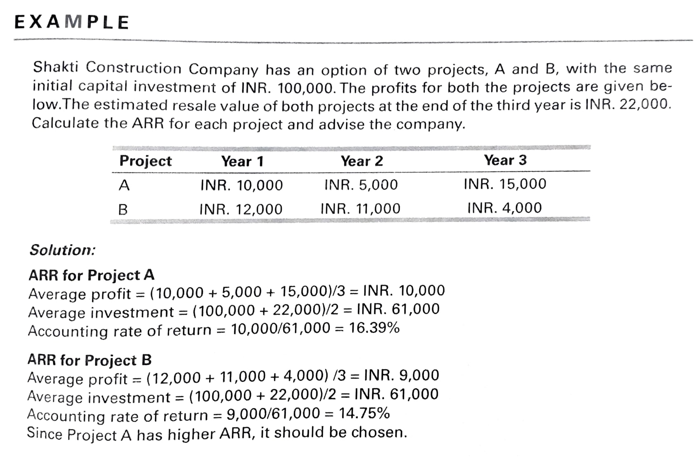
Accounting Rate of Return (ARR)
$$ARR= \frac{\text{Average} \text{annual} \text{profit} \text{after} \text{taxes}}{\text{Average} \text{investment} \text{over} \text{the} \text{life} \text{of} \text{the} \text{project}}$$
This is also referred to as the average rate of return on investment. It is a measure of profitability which relates income to investment, both measured in accounting terms.
The limitation of the ARR method is that it uses profit rather than cash flows

Slide 22





Time Value of Money
Future value
Present value
Business
man
Common
man

Slide 23
Time Value of Money
Time Value of Money ► Financial Decision Making
Financial management is future oriented.
A financial decision taken today has implications for a number of years, that is, it spreads into future.
One basic requirement of comparability is the incorporation of time element in the calculation.
In order to have a logical and meaningful comparison between cash flows that accrue in different time periods. It is necessary to convert the sums of money to a common point of time.
‘Time value of money’ means that the value of money is different in different time periods.

Slide 24
Time Value of Money
Concept Which states that purchasing power of money differs with the passage of time
Effect of time value of money on daily routine life:
1. Spending, 2. Saving, 3. Borrowing and 4. Investing
Present Value
Cash on hand, Amount you need to reach future value, uses discounting
PV = FV $\frac{1}{{(1+r)}^{n}}$
PV = FV 1/〖(1+𝑟)〗^𝑛
Future Value
Amount you will receive at a given future date, uses Compounding
FV = PV ${(1+r)}^{n}$
FV = PV 〖(1+𝑟)〗^𝑛

Slide 25
Time Value of Money
Time Value of Money can also be referred to as ‘Time preference for money’.
The time preference for many is therefore expressed generally in terms of rate of return or more popularly as a discount rate of return & expected rate of return.
Suppose :
You given a choice of getting 1000/- either now or one year later.
Rational Behaviour

Slide 26
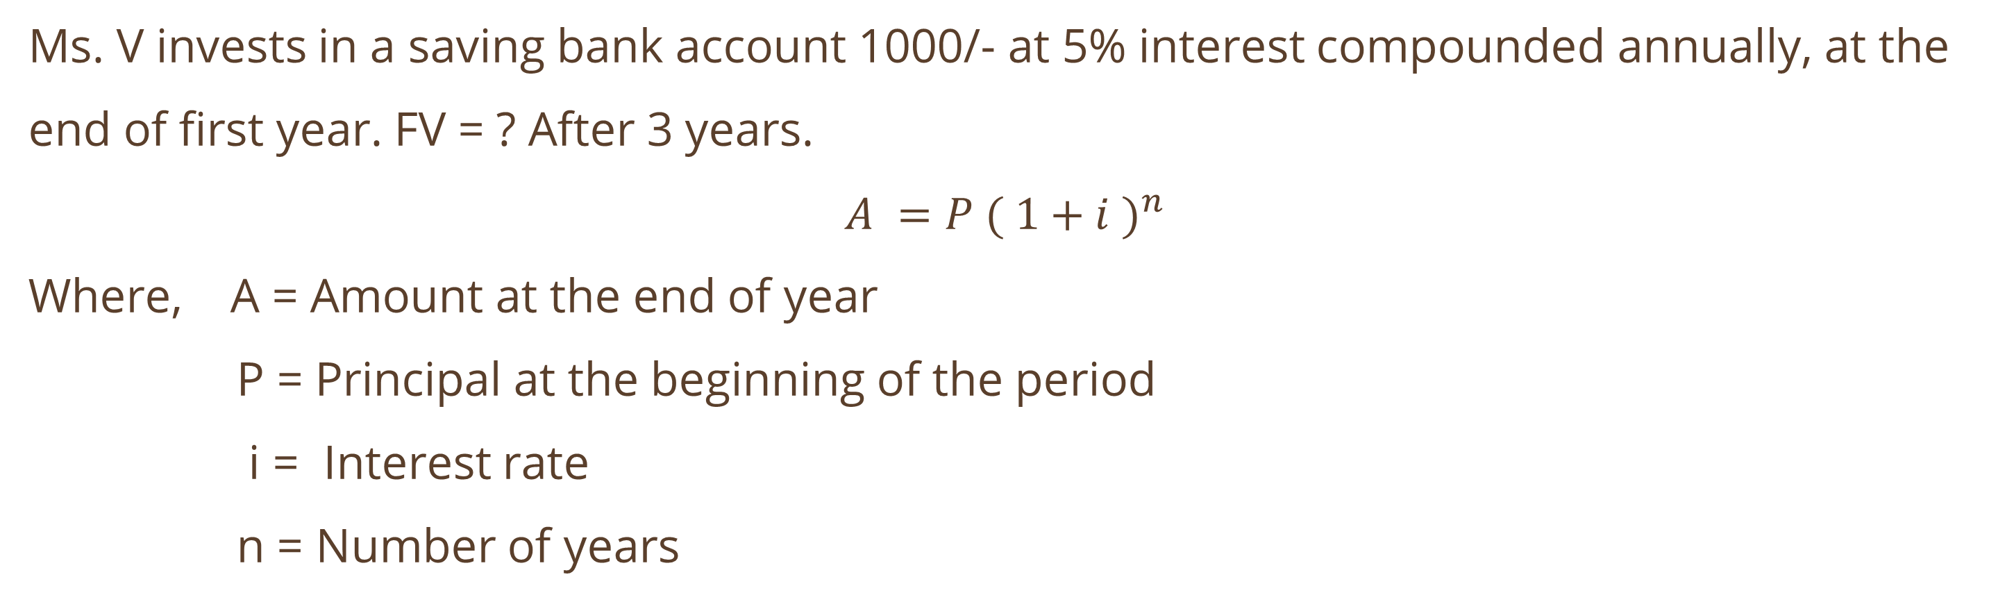
Compounding Technique
Interest is compounded when the amount earned on an initial deposit (the initial principal) becomes part of the principal at the end of the first compounding period. The term principal refers to the amount of money on which interest is received.
1.1 Annual Compounding
Ms. V invests in a saving bank account 1000/- at 5% interest compounded annually, at the end of first year. FV = ? After 3 years.
$A =P {( 1+i )}^{n}$
Where, A = Amount at the end of year
P = Principal at the beginning of the period
i = Interest rate
n = Number of years

Slide 27
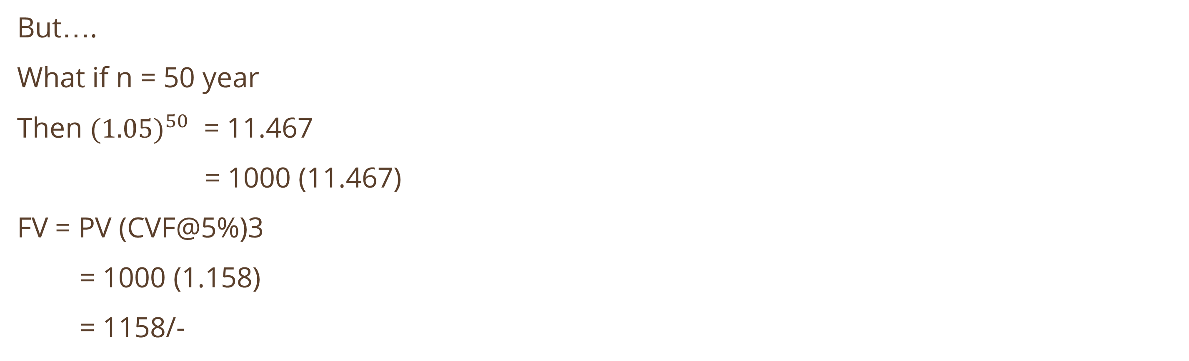
1.1 Annual Compounding
Year | Amount | Interest | Total
1 | 1000 | 50 | 1050
2 | 1050 | 52.50 | 1102.50
3 | 1102.50 | 55.125 | 1157.625
But….
What if n = 50 year
Then ${(1.05)}^{50}$ = 11.467
= 1000 (11.467)
FV = PV (CVF@5%)3
= 1000 (1.158)
= 1158/-
Notes:
If an investor deposits 20000/- with a bank in which is paying interest at 8% on 15 year time deposits. What will be future value ?

Slide 28
1.2 Semi - Annual Compounding
Means that there are two compounding periods within the year. Interest is actually paid after every six months at a rate of one – half of the annual (Stated) rate of interest.
Mr. Q places his savings of 1000/- in a two year time period scheme of a bank which yields 6% interest compounded semi-annually. He will be paid 3% interest compounded over four periods – each of six months’ duration.
Year | Months | Amount | Interest | Total
1 | 6 | 1000 | 30 | 1030
 | 12 | 1030
2 | 18
 | 24

Slide 29
1.3 Quarterly Compounding
Means that there are four compounding periods within the year. Instead of paying interest once a year, it is paid in four equal installments after every three months.
Using the same example of 1.2 interest for each compounding year will be 1.5%
Year | Months | Amount | Interest | Total
1 | 3 | 1000 | 15 | 1015
 | 6 | 1015
 | 9
 | 12
2 | 15
 | 18
 | 21
 | 24

Slide 30
1.4 Annual Compounding of series of payments
In many instances, we may be interested in the future value of a series of payments made at different time period.
Ms. R deposits each year 500/-, 1000/-, 1500/-, 2000/-, 2500/- in her saving bank account for 5 years. The interest rate is 5%. Assume that the compounding period is one year and payment is made at the end of each year. She wishes to find the future value of her deposits at the end of 5th year.

Slide 31
1.5 Compound sum of an annuity
An annuity is a stream of equal annual cash flows.
Mr. Y Deposits 2000/- at the end of every year for 5 years in his saving account paying 5% interest compounded annually. He wants to determine how much sum of money he will have at the end of 5th year.
Year | Amount | No. of year Compounded | CVF | FV
1 | 2000 | 4 | 1.216 | 2432
2 | 2000 | 3 | 1.158 | 2316
3 | 2000 | 2 | 1.103 | 2206
4 | 2000 | 1 | 1.050 | 2100
5 | 2000 | 0 | 1.000 | 2000
Future Value |  |  |  | 11054
FV = 2000 (CVFA@5%)
= 2000 (5.527)
= 11054/-

Slide 32
Discounting Technique
(Present Value Approach) money is received at same future date and will be worth less because the corresponding interest is lost during the period.
Present value of a rupee that will be received in the future will be less than the value of a rupee in hand today.
It is concerned with determining the present value of a future amount, assuming that decision maker has an opportunity to earn a certain return on his money.
This return is designated in financial literature as the discount rate, the cost of capital or an opportunity cost.

Slide 33
2.1
Mr. B has been given an opportunity to receive 1060/- one year from now. He knows that he can earn 6% interest on his investment. The question is : What amount will he be prepared to invest for this opportunity ?
$PV=FV \frac{1}{{\left(1+r\right)}^{n}}$ or P $=A \frac{1}{{\left(1+i\right)}^{n}}$

Slide 34


2.2
Mr. G wants to find the present value of 2000/- to be received 5 years from now. Assuming 10% rate of interest.
$$PV=1242/−$$
The sum of 1242/- will be compounded to 2000/- in five years at 10% rate of interest (1242 *1.611 = 2000.862)
Present Value of a series of cash flows.
$P= \frac{{CF}_{1}}{{(1+i)}^{1}}+ \frac{{CF}_{2}}{{(1+i)}^{2}}$ + $\frac{{CF}_{3}}{{(1+i)}^{3}}$ + ….. + $\frac{{CF}_{n}}{{(1+i)}^{n}}$

Slide 35
2.3 Present Value of mixed stream of cash flows
N = 5 years
i = 10%
Year | Amount
1 | 500
2 | 1000
3 | 1500
4 | 2000
5 | 2500
Year | Amount | PVF @ 10% | PV
1 | 500 | 0.909
2 | 1000 | 0.826
3 | 1500 | 0.751
4 | 2000 | 0.683
5 | 2500 | 0.621
Present Value
= 5325.5

Slide 36
2.4 Present Value of an annuity of 1000/- for five year
Use annuity
= 3790/-
ABC Company expects to receive 100000/- for a period of 10 years from now project it has just undertaken. Assuming a 10% rate of interest. How much would be the present value of this annuity ?
= 614500/-

Slide 37
2.5 Present value of uneven cash flows having annuity.
ABC Company expects cash in flows from its investment proposal. It has undertaken in time period zero, 200000/- and 150000/- for first two years respectively and the expects annuity payment of 100000/- for the next eight years, what would be the present value of cash in flows, assuming a 10% rate of interest.
= 746600/-

Slide 38
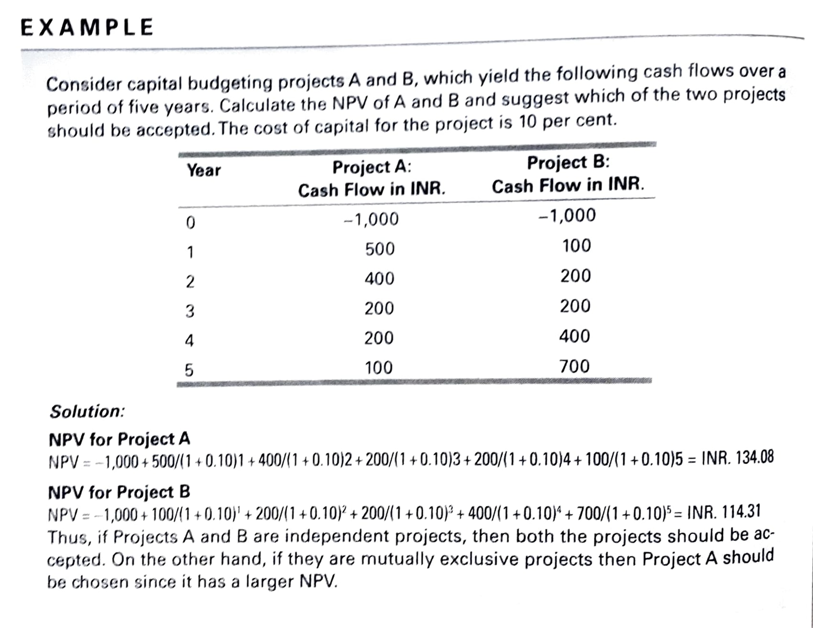
Net Present Value (NPV)
$NPV=\sum_{t=0}^{n}{.} \frac{{CF}_{t}}{{(1+r)}^{t}}$ = $\frac{{CF}_{0}}{{(1+r)}^{0}}$ + $\frac{{CF}_{1}}{{(1+r)}^{1}}$ + … + $\frac{{CF}_{n}}{{(1+r)}^{n}}$
For a project to be viable, the net present value of the project has to be positive. A negative net present value indicates that the project is not viable. When choosing among mutually exclusive projects, the project with the largest (positive) NPV should be selected. The NPV calculated as the present value of the project's cash inflows minus the present value of the project's cash outflows.

Slide 39
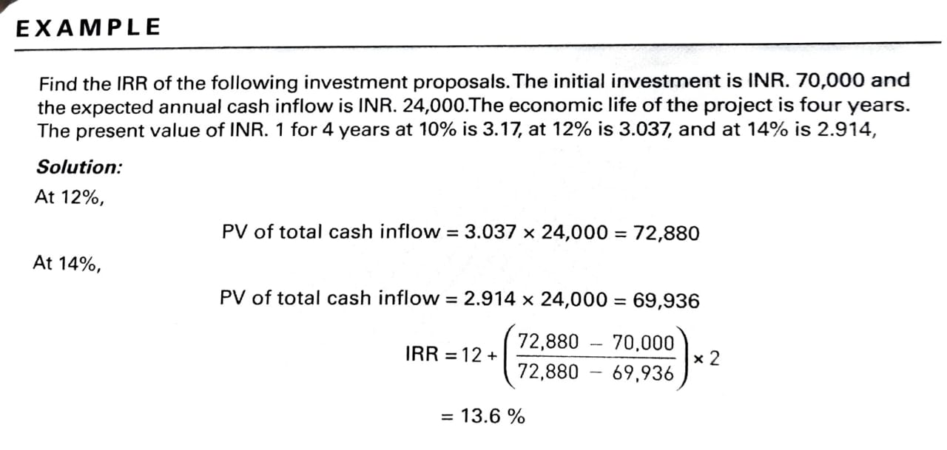

Internal Rate of Return (IRR)
IRR is sometimes referred to as the "economic rate of return." IRR is the rate of return on an investment. the rate of return at which the net present value of a stream of payments/incomes is equal to zero. It is the discount rate which equates the present value of future cash flows with the initial investment.
$Investment=\sum_{t=1}^{n}{.} \frac{C_{t}}{{(1+r)}^{t}}$

Slide 40
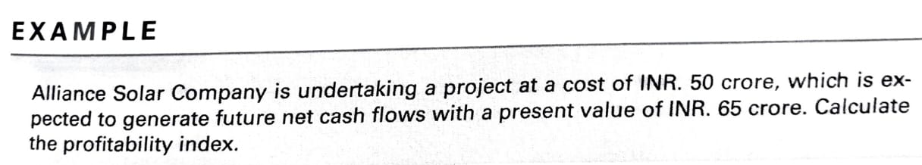
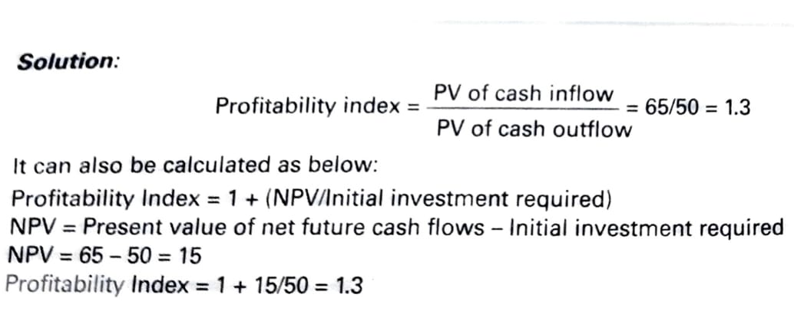

Benefit-Cost Ratio (BCR)
The BCR is also referred to as the "profitability index. "It is an investment appraisal technique. Profitability index is actually a modification of the net present value method. While NPV is an absolute measure as it gives the total value in Indian rupees for a project, the profitability index is a relative measure as it gives the value in the form of a ratio.
$$BCR=BCR=\frac{PVB}{I}$$
$$Net Benefit − Cost Ratio \left(NBCR\right)=BCR−1$$
Profitability index = 1+(NPV/Initial investment required)

Slide 41
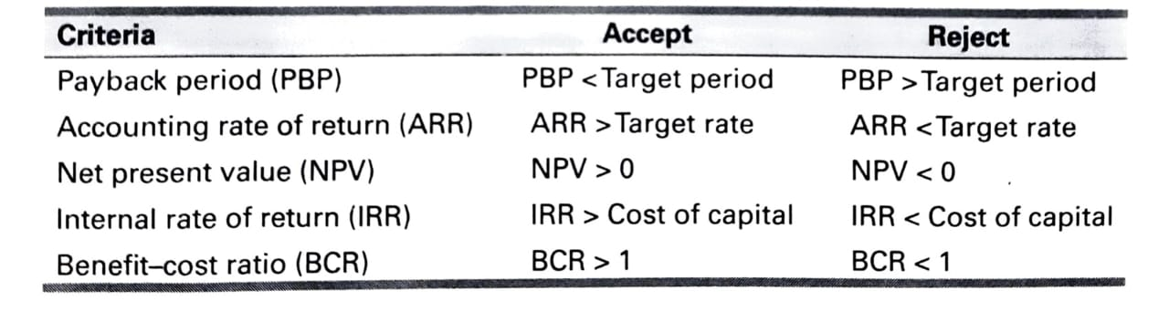
PROJECT FINANCING
Equity Financing
Debt Financing
Equity Capital
Preference Capital
Internal Accruals
Venture Capital
Angel Investing
Term Loans
Debentures

Slide 42
PROJECT IMPLEMENTATION PHASE
The implementation phase for a project involves the setting up of facilities. For project planning and control, two basic network techniques are available program evaluation and review technique (PERT) and critical path method (CPM) These techniques help in monitoring the project. Once the project is commissioned, performance review is done periodically to compare the actual performance with projected performance.

Slide 43


Working Capital
Funds that a company must possess to finance its day to day operations.
Net of current assets minus current liabilities
Equals to the value of raw materials, work in progress, finished goods inventories and accounts receivable less accounts payable
It is a short term fund needed to meet operating expenses.

Slide 44
Gross Working Capital
Net Working Capital
Sum of all current assets that appear in the balance sheet
Working Capital
The excess of current assets over current liabilities
Permanent
Temporary
Assets that are required on a continuing basis over the entire year
Working Capital
Additional assets required at different times during the year

Slide 45
Determinants of Working Capital
Nature Of Business
Sales and Demand Conditions
Technology and Manufacturing policy
Credit Policy
Availability of Credit
Operating Efficiency
Price Level Changes

Slide 46
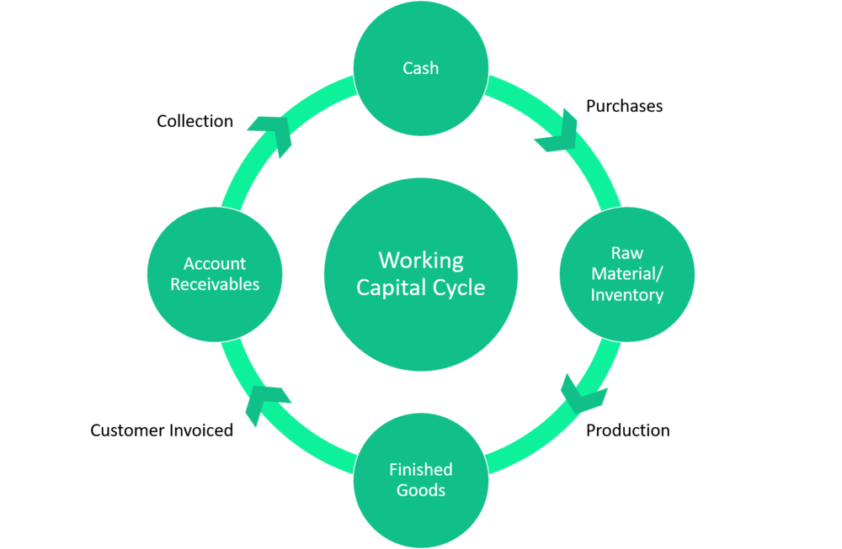




Working Capital Cycle
$$Working Capital Cycle=Inventory days+Receivable days −Payable days$$
$Inventory days =\frac{Inventory}{Cost of sales}×360 days$
$Receivable days =\frac{Receivables}{Sales}×360 days$
$Payable days =\frac{Payables}{Cost of Sales}×360 days$

Slide 47
Sources of Working Capital
Long term Financing
Short-term Financing
Spontaneous Financing
Determine the working capital required to finance a level of activity of 180,000 units of out put for a year. The cost structure is given below:
Particulars | Cost Per Unit (INR)
Raw materials | 20
Direct labour | 5
Overheads (including depreciation of INR. 5) | 15
Total cost | 40
Profit | 10
Selling price | 50
Additional Information:
Minimum desired cash balance is INR. 20,000.
2. Raw materials are held in stock, on an average, for two months
3. Work-in-progress (assume 50 percent completion stage)will approximate to half a month's production.
4. Finished goods remain in the warehouse, on an average, for a month.
5. Suppliers for materials extend a month's credit and debtors are provided two month’s credit. The cash sales are 25 per cent of total sales.
6. There is a time lag in payment of wages for a month and half a month in the case of overheads.

Slide 48

Particulars | Amount in INR
A. Estimation of current assets
Raw materials: (180,000 x 20 x 2)/12 | 600,000
21/12Work-in-process: (180,000 x 35 x 0.5)/12×0.5 | 131,250
Finished goods: (180,000 x 35 x 1)/12 | 525,000
Debtors (75% of total units produced): (135,000 x 35 x 2)/12 | 787,500
Cash balance | 20,000
Total current assets | 2,063,750
B. Estimation of current liabilities
Suppliers: (180,000 x 20 x1)/12 | 300,000
Wages: (180,000 × 5x 1)/12 | 75,000
Overheads: (180,000 × 10/10.5)/12 | 75,000
Total current liabilities | 450,000
C. Working capital (A-B) | 1,613,750
Solution:

Slide 49

THANK YOU

